Slide 1
ESYS-FINAL
TAKEAWAY
李俊廷、施冠宇、洪世昌

Slide 2
MOTIVATION:
Foopanda, uber eat often mess our orders.
Accident might happen to an elder who has no cell phone by herside.

Slide 3
IMPLEMENTATION
Send a gps data when there is an accident happened.
GPS module(neo-6m) & STM32L4 accelerometer
When an abnormal high acceleration on bike or motorbike sensed by the stm32,
=>It will send a gps data(NMEA $GPRMC) to a webpage to let the customer knows.

Slide 4
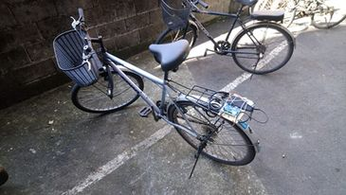
Data Analysis
蒐集並分析正常、急煞、轉彎、滑動、蛇行、傾斜等騎乘方式的加速度資料，判斷駕駛是否正常行駛。

Slide 5
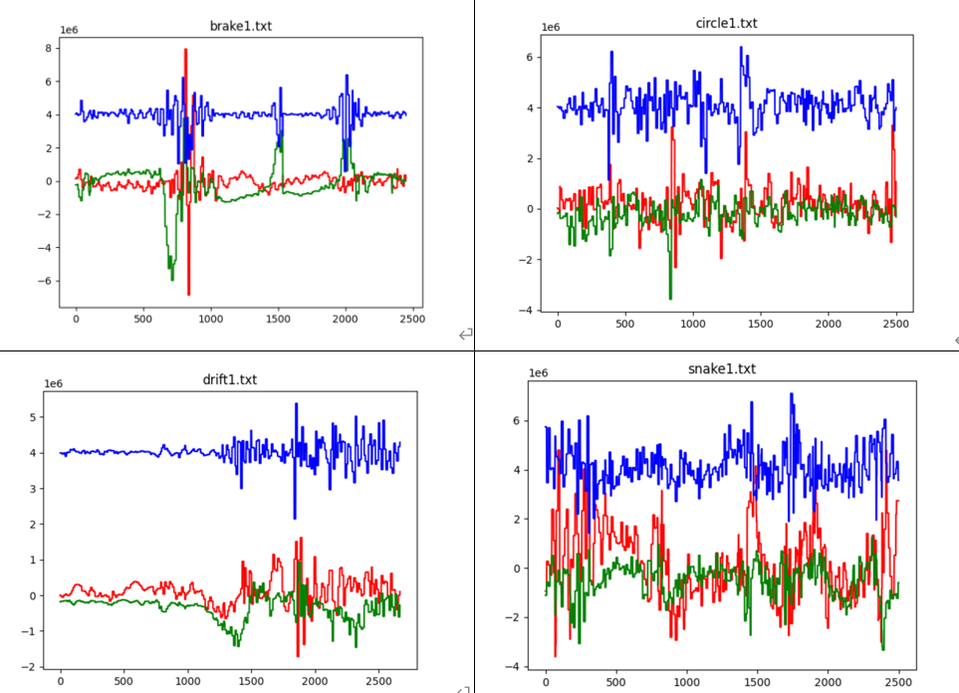

Slide 6
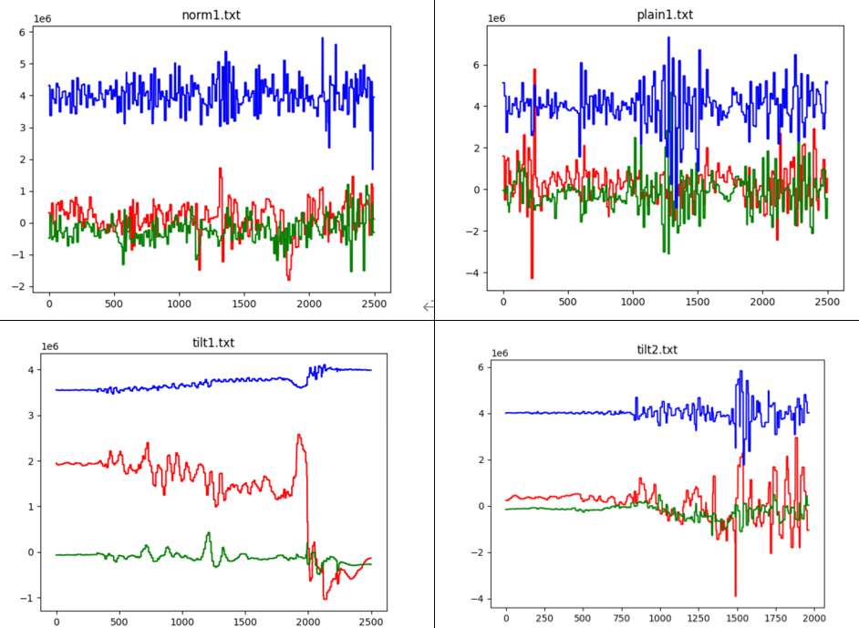

Slide 7
Fuzzy Classification
建立大小為80（約1s）的buffer，紀錄一秒內的加速度大小。
Axi表示為x軸加速度統計量所對應之歸屬函數程度，並將其畫分為 L=Low 、 M=Medium、H=High。而 i 分別代表為加速度大小H=(+1, inf)、M=(-1, +1)、L=(-inf, -1)。
Ayi, Azi同理。

Slide 8
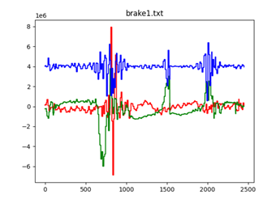
Data Processing
使用fuzzy classification為每項騎乘方式分類。透過 x 軸、y 軸及 z軸的加速度值來決定其加速度的統計量，並設定模糊規則作為模糊分類器的規則庫。
for example, Rule1:
If ((AxM is L) or ((AxH is M) and (AxL is M)))
and (AyL is L)
and ((AzH is M) and (AzL is M))
then (G is Brake)

Slide 9
Data Transmit
透過wifi，在終端(mbed)建立socket client，將資料傳送給socket server(電腦)。為降低耗能，終端只在有不當駕駛行為時傳送通知，內容包含行駛方式與當前GPS定位。

Slide 10
Issue to be solved:
Start up acceleration value is not precise
Gps data might take a while for TTFF
Gps signal is too weak indoor for neo-6m

Slide 11
REFERENCE:
https://os.mbed.com/teams/mbed-os-examples/code/mbed-os-example-mbed5-wifi//annotate/86dca48315d8/main.cpp/
http://aprs.gids.nl/nmea/
https://os.mbed.com/users/nliu96/code/GPS-Library/
基於加速度特徵值之模糊手勢識別系統
http://163.17.20.49/IJAIT/IJAIT%207(2)/IJAIT%207(2)_09.pdf

Slide 12
DEMO:
https://youtu.be/iPRQWVrca58
https://youtu.be/Oq1QwztKsbk
https://youtu.be/C6c5yXrH1KQ

